Slide 1
IBM Services Platform with Watson Dynamic Automation
Chris Molloy
IBM Distinguished Engineer
Enterprise IT Advisor Team

Slide 2
Contents
Overview – what does it do, what is included and what is not?
Value Proposition – why should a client want this?
Common Scenarios – what are the most common use cases and the solution selection criteria for each?
Delivery – what are the available delivery options and what dependencies exist on tools and infrastructure?
Solution Design – how do you design and cost the solution and any associated services / service levels?
Solution Guidance – what tips and lessons learnt do we have from prior work?
Further Help – who can provide further support and what additional resources are available?
Supporting Information – appendices with detailed supporting information

Slide 3
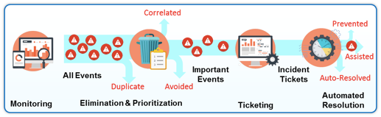
Capability Overview
Dynamic Automation is a comprehensive solution designed to leverage automation as the primary method of service delivery.
Dynamic Automation is a service that interfaces with processes in customer SO accounts to deliver an automated response to defined workload. Examples include infrastructure events, end user requests, and standard changes for which a response or delivery action can be provided via system automation.
It is based on a product called IPCenter from the company called IPSoft as the core technology to support the automation processes.

Slide 4
Process change: Autonomics as a new step in the IT Operations support flows
Today
Manual Automation
Event
Monitor
Ticket
Cut
Escalate to queue
Technicians
Remote Access
Dispatcher
Inserting Automation
Virtual Engineer
Dispatcher
Tomorrow
Automated ticket solution
If not
remediated
Event
Monitor
Ticket
Cut
Escalate to queue
Technicians
Tickets handled via automation
Remote Access
Remote Access
Notes:
The result of the Dynamic Automation deployment is the introduction of a new step in the service operations flow; namely, after deeming an event actionable but before dispatching it to humans. Humans are engaged only if automation is unable to fully remediate the situation at hand. An incident ticket is always opened in the client IPC system to capture all actions.

Slide 5
Driving IT infrastructure availability by autonomous event resolution and request fulfillment
Events
Event Aggregation
Dynamic Automation “Virtual Engineer”
Dispatch (unresolved)
Queues
Activity Requests
!
!
!
!
!
!
!
Automation
Learns & evolves
Best practices
Defect prevention process
Continuous Service Improvement and Analytics
Automation Library managed across IBM’s portfolio
Client knowledge database
Knowledge management database
Notes:
Dynamic Automation is a comprehensive solution designed to leverage automation as the primary method of service delivery. It automates tasks relative to incident response and service request fulfillment. This framework provides IBM with the ability to extend rapid, consistent, scalable, and quality services to clients. DA can be applied to the management of servers, storage, databases, middleware, groupware, and other business applications. Dynamic Automation’s virtual engineers interface with a client’s IT Service Management tools to automate client-specific use cases. They will not require replacing any investment a client may have made in tooling and automation, and will also not require the deployment of agents on end nodes. They will simply interface with systems remotely, simulating how technicians support these environments. Dynamic Automation includes an analytics engine to a) identify automation use cases, b) identify improvement opportunity in deployed use cases, c) identify patterns in the problems automation is responding to, and d) promote lessons learned from IBM’s global deployments to specific clients. The combination of these provides Dynamic Automation with a robust Continual Service Improvement capability.
“Activity Requests” may be Change requests, Service Requests or other requests from specific application integrations

Slide 6
Automation is re-ordering the way we do work in the delivery of services
Global status & sample results (Sept, 2017)
“Automation
is core to our services…”
18%
Clients
34%
Clients
49%
Servers
29%
Servers
Implementation in our server base
11%
Clients
12%
Servers
Global deployment across clients
30%
Clients
8%
Servers
800+
Clients in
process automation
465 K
Devices
covered
Incidents
processed since mid-2014
12.8M
Notes:
We started this journey with a heavy investment in Automation and boarding clients into our automation platform a year ago. We have deployed to nearly 750 clients and over 385K servers. We have processed over million incidents. Currently, in NA, where we started, we are handling 61% of the incidents as auto-resolved (remediated) and/or auto-assisted (diagnostic).
Client and Server percents by Geography are not relative to the geography population (clients/servers); they are the percents of the totals at the bottom.

Slide 7
Automation impacts are realized soon after a deployment – One client example
“…with quality benefits for our clients.”
“File System Full” Example
FROM: > 110 minutes
TO: < 10 minutes
Incidents auto-resolved / assisted
68%
14%
Increase in average productivity
Decrease in “Priority 3” incidents
29%
9%
Decrease in “Priority 4” incidents
Faster response & resolution times
Improvement in non-critical event handling
Notes:
We are seeing an average of 14% productivity and expect it to grow as we get to 100% server penetration, and grow remediation and diagnostic data in the incident space and expand to change management, service requests and scheduled automations. Client benefits are seen with improved quality of service and in this example, a few short months post deployment, Priority 3 tickets for the client decreased 29% and Priority 4 saw a 9% decrease. This should improve as more virtual engineers are deployed in the coming months. Another benefit is dramatic improvement in MMTRs. Mean Time to Respond improves since one does not have to wait on an System Administrator to be assigned and react. On a specific account, it used to take >110 minutes to address a “file system full” and now it takes less than 10 minutes.

Slide 8
Value Proposition – Benefits of Dynamic Automation
Consistency of outcomes
Reduction of error rates
Enhanced response & remediation times
On-demand scalability to meet peak and/or asymmetric workloads
Enrichment of inputs to human engineers
Zero disruption to client’s IT environment
Quality of service
Notes:
Dynamic Automation slots seamlessly into existing delivery models and provides consistent, rapid, and predictable response. Even when humans are required to engage, automation can facilitate and enrich their response. In all cases, leading to improved service quality.

Slide 9
Common Usage Scenarios, Selection Criteria and Positioning
IMI Deals :
For any deal including IMI, Dynamic Automation is already part of the solution
Traditional SO FWB based Deals:
Include Dynamic Automation in your solution
Use Standard Dynamic Automation costing & savings ratios built in SDM
IMC Deals ( India Domestic Shared Delivery ) :
Reach out to the SMEs in the contacts list
Labour dedicated on premise :
Establish connectivity to the shared Dynamic Automation instance
Add costs as per guidance
Negotiate savings with Delivery
Island Accounts ( Do not allow connectivity to shared instance of Dynamic Automation )
Evaluate the business case for a dedicated instance of Dynamic Automation

Slide 10
Delivery Model and Options
Shared model
Preferred model for all deals
Dedicated Model
Dedicated applies to Large Complex deals
Dynamic Automation is mandatory and must be included in all new SO deals to drive Labour efficiency
Exception criteria:
Client does not allow use of offshore tools due to policy or regulatory reasons
Environments where DA is not supported ( Mainframe, End User only deals )
Extended with IBM Watson
Moving from the deterministic to non-deterministic: IBM Watson integrated with Dynamic Automation will perform problem determination.
IBM Watson is being used to identify event patterns, their possible root causes and the diagnostics for automation to run in order to reduce the possibilities.
Then the correct automation is run to remediate.
Allows a much larger scope of problems to be successfully remediated, increasing business availability.

Slide 11





Dynamic Automation ←→ Analytics
Close ticket
SME
Requests / changes / schedules
(on-demand)
If fulfilled
Cognitive
& Analytics
Automation integration module
Update ticket
If not fulfilled
Escalate to queue
Alerts
(Reactive)
Virtual Engineer
Defect prevention process
Remote access
Continuous Improvement and Analytics
Autonomous fulfillment
Process Improvement
Knowledge management database

Slide 12
Dynamic Automation integrates into existing ITSM tools to automate use cases on platforms, database, middleware apps, network, and storage
Dynamic Automation “Virtual Engineer” (System Administrator)
Client Devices
Netcool
Event
Management
Unix
Managed Server #1
Integration Services
Jump host*
Managed Server #2
ServiceNow
Incident Ticketing
IBM Dynamic Automation
Intel
Diagnose
Escalate it to a human system administrator to complete the resolution.
Virtual engineers behave very much like a human system administrator.
Remediate
Yes
No
Escalate to
Human Engineers
Notes:
The deployment of Dynamic Automation entails integrating its automation repository with the client’s event management and IPC systems through an IBM capability called Integration Services (a systems message broker). These systems can be on the IBM or client networks. A pair of jump host, or network proxy, appliances will be built on the client network to serve as the the virtual engineers’ landing spot. From there, virtual engineers will login to every end node that is in scope over a secure connection.

Slide 13
Typical Infrastructure Overview (Simplified)

Slide 14
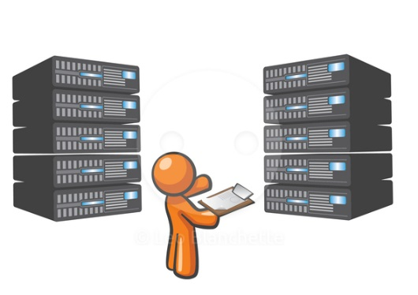

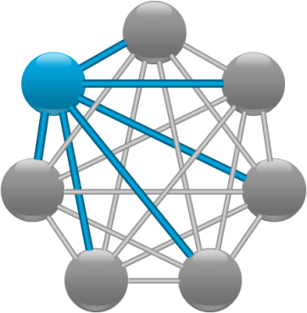
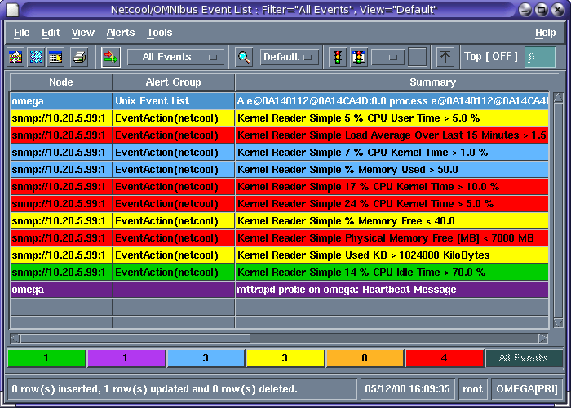
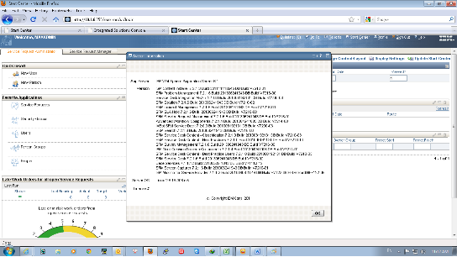
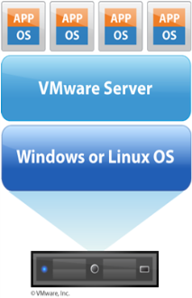

Application Level View – End to End Flow
IPCenter
3
1. Monitoring detects issue and raises an event into existing event system (e.g. Netcool)
Softlayer
3. IPCenter determines whether an Automation is applicable and sends ticket data to IPC
2. Events raised into IPcenter
6. IPCenter analyses and steps through workflow until complete
Customer Servers
3a. Ticket raised in IPC
4a
1
2
7. Ticket updated in IPC
7
4b
6
4a
Integration Hub
8
4. Commands executed using standard mechanisms (e.g. SSH / Powershell)
5. Output sent back to IPcenter
8. Tickets updated and/or resolved and placed in original target resolver group
5
Existing Monitoring and Ticketing
Customer Servers

Slide 15
FwB v74 Status
 | North America | Europe | Asia Pacific | Latin America | Japan
Stage 1: Dynamic Automation
Platform Support | 30% | 30% | 20% | 20% | 30%
SysOps | 30% | 30% | 20% | 20% | 30%
MW/DB | 30% | 30% | 20% | 20% | 30%
Stage 2: Server Lifecycle Automation
Platform Support | 20% | 20% | 20% | 20% | 20%
System Sec Checking | 75% | 75% | 75% | 75% | 75%
Security Advisory and Integrity | 75% | 75% | 75% | 75% | 75%
MW/DB | 0% | 0% | 0% | 0% | 0%
SMO/Batch (SSD Savings) | 0% | 0% | 0% | 0% | 0%
Sec Compliance Regulatory | Next FwB update | Next FwB update | Next FwB update | Next FwB update | Next FwB update
Stage 3: Robotic Process Automation | Next FwB update | Next FwB update | Next FwB update | Next FwB update | Next FwB update
Stage 3: Software Defined Infrastructure Control | Non Labor Savings¹ | Non Labor Savings¹ | Non Labor Savings¹ | Non Labor Savings¹ | Non Labor Savings¹
Stage 3: Automated Storage Provisioning | Embedded standard² | Embedded standard² | Embedded standard² | Embedded standard² | Embedded standard²
Notes:
SDIC Savings for IBM owned HW – Guidance of 20% savings on Hypervisor; Alternate upsell offering for client retained HW/SW. For next FwB, will work with Global SLE for potential efficiency (25%) on DS perf/cap
Efficiency/Productivity benefits of ~20% are included in standard FwB ratios via assumed automation

Slide 16
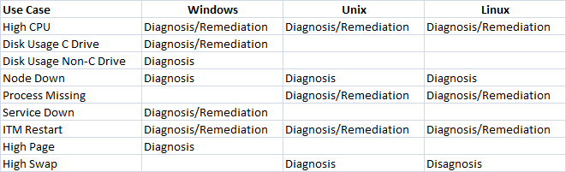

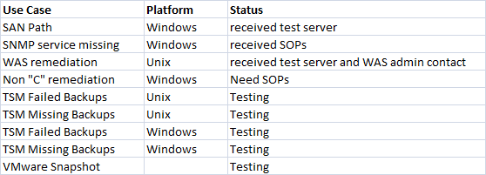
Continuous Improvement Approach: Snapshot Client X
Client’s Current Automation
Planned Automation (next release)

Slide 17
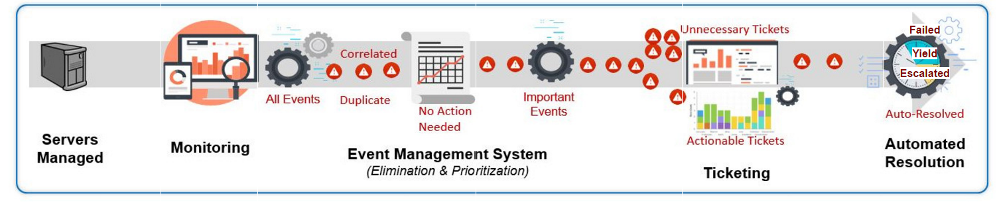
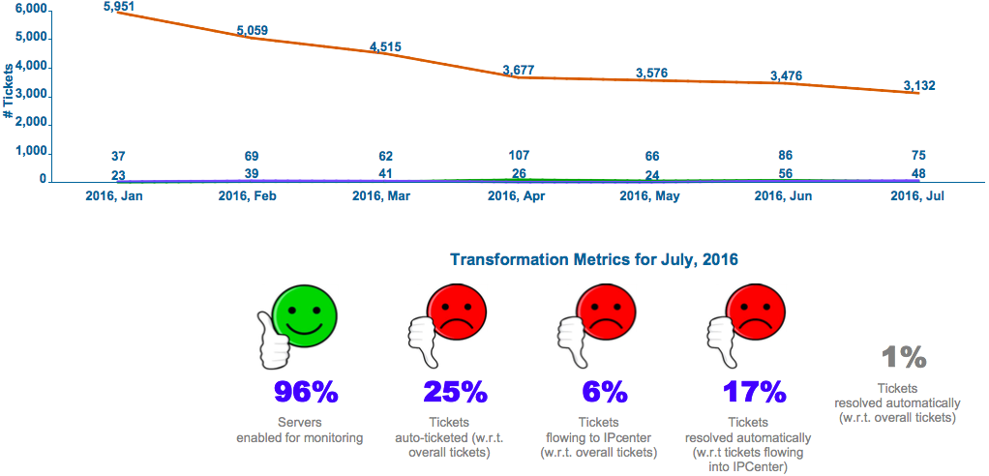
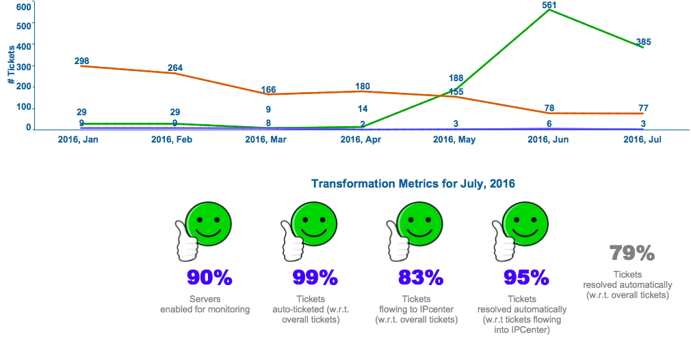
Stage 1: Best of Breed Dynamic Automation
50%+
100%
80%
100%
65%
Getting to Best of Breed Dynamic Automation
Get event automation going and focus on automata that resolve events
Get the maximal set of automata deployed to resolve events based on experience in highest performing accounts
Flow all incident ticket generating monitoring events to IPCenter
Increase monitoring coverage and auto ticket all of them
Expand incident automation to network devices
2017 Targets
Get to 50% of overall incident ticket volume being automatically resolved.
Auto-ticketing is not as wide-spread as it needs to be and not enough of the auto-ticketed events are routed from event management systems to IPCenter
Only a subset of automata are deployed.
Saving Opportunity: 810 FTEs WW in 2017

Slide 18
Solution Guidance
T&T should include implementation costs for Auto Ticketing and integration of the service management tools
Before considering DA on a specific account, there are some pre-requisites that need to be met :
Client approval to deploy and provide support using dynamic automation
Deployment of a Jumphost requiring a VPN Client to be deployed either in the customer's network or a DMZ connecting to the client network for Unix/Linux devices
Deployment of a Windows Jumphsot inside the clients network to support Windows devices
ID's and keys to enable connectivity to the Linux end points and the Jumphost ID and password for the Windows endpoints
ID's to have privileged access to support SOP's defined to support the automation(s)
No software or agents are to be deployed for the automation process
Existing DNS on the client's environment will be used to support automation(s)
Auto-ticketing should be in place to integrate with the shared DA instance
DA’s virtual engineers interface with a client’s IT Service Management tools to automate client-specific use cases. They will not require replacing any investment a client may have made in tooling and automation, and will also not require the deployment of agents on end nodes. They will simply interface with systems remotely, simulating how technicians support these environments.

Slide 19
Scoping and Estimating
Shared Model :
As of July 2017, a cost of $5 per image is already included in the FWB template when DA is ’switched on’. DA is turned ON by default.
Include costs for connectivity to the shared DA instance
GSNI link
Gateways and Jumphosts
2 linux and 2 windows images
Dedicated Model :
Contact SMEs for guidance
Benefits are already embedded in FWB ( For SIH East : one time labour reduction of 20% in Month 13 )

Slide 20
Implementation Guidance
DA Service Levels and Maintenance Windows
Internal SLO are for internal use and should not be shared with clients.
Priority 1 with failover -- 4 hours
Priority 2 -- 3 Calendar Days
Priority 3 -- 14 Calendar Days
Priority 4 -- 60 Calendar Days
Other - NO SLO
"Outage" means IPcenter is unavailable. Automation is not running for ALL accounts boarded on the instance.
"Service Degradation" means IPcenter is available but some impact is being experienced. For example, automation may be executing on some but not all accounts or automation may be running but delayed for all accounts.
"Planned Outage or Planned Downtime" means that IPcenter is unavailable due to some maintenance with supporting pre-approved change records.

Slide 21
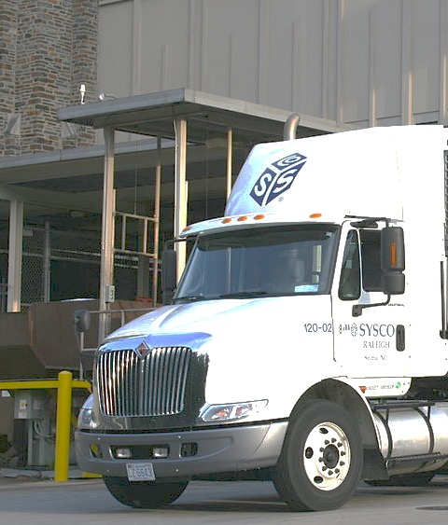

Case Study
What we achieved
How we got there
“ We need our trucks to leave on time… through automation we were able to reduce critical issues by more than 89%... we’ve [decreased our server downtime] by over 50%.”
Frank Merli, VP of Infrastructure and Cyber Security, Sysco
1 Your key customer engagement / digital business needs are…
Globally, 8,000 trucks must perform 150,000 timely deliveries, every day
Consistently deliver 1.8 billion cases of food a year, on time
2 To deliver on those needs, what matters most from IT is…
Consistent on-time delivery totally depends on IT uptime— there’s no room for error
3 The key offerings, cognitive and automation capabilities deployed are…
Dynamic Automation applied to ~4000 servers to rapidly process huge amounts of data, as well as to identify and fix problems instantaneously
5 The IT and business outcomes we achieved together are…
Reduce critical issues by more than 89%
Reduce average time to solve issues from 19 hours to 28 minute
Notes:
Note, we “fixed” quote .. Frank had idea right but used wrong actual words ..
Large global food service delivery company that must perform 150,000 timely deliveries every day to deliver 1.8B cases of food annually, applied Dynamic Automation 4,000 servers
to rapidly process huge amounts of data, as well as identify and fix problems instantaneously. In doing so it has reduced critical issues by more than 89% and reduced average time to solve issues from 19 hours to 28 minutes.
One of the largest global shipping companies has automated nearly 4,000 servers. This has enabled the shipping magnet to auto resolve over 98K trouble tickets and almost 60K auto assisted resolution tickets.
It is also has a number of new projects underway that include:
Risk Based Continuous Patching and Hybrid Cloud Deployment Services
Utilize Cognitive Delivery Insights to support the strategy going forward
Implement Business Analytics Services to replace legacy reporting

Slide 22
Global Deployment Successes
Client examples
Healthcare Provider:
In 6 months, 50% of all tickets were automated, reducing MTTR from 41 hours to 14 minutes
Public Sector Client: 70%
of all incidents and 90% of Sev 1 incidents are now managed by DA, reducing average handling time by 50%
The IBM Account: 7.8 minutes Mean Time To Resolve & 48 seconds Mean Time to Respond (MMTR)
Distribution Client: 53% of total incidents were auto-resolved, saving 32,380 minutes (~540 hours)
Average of 50-100 minutes of saved labor per autonomous resolution/fulfillment
Up to 40 minutes of saved labor per automated assistance
Notes:
Additional examples of statistics from several client deployments.

Slide 23
Additional Resources – Supporting Materials
Dynamic Automation organization roles and contacts by geography
https://w3-connections.ibm.com/wikis/home?lang=en-us#!/wiki/IPGS%20Wiki/page/Organization%20%20Roles%20and%20Contacts
Resources in the global automation community here: Global Automation: DA Info Repos
Separate Dynamic Automation Wiki here: Dynamic Automation - Dynamic Automation Wiki
AP Dynamic Automation Community
Education Material
Support Organization
SLO and Operational Support Contact Information
Account Onboarding
(for Japan) Dynamic Automation - Japan Community
End to End Overview of the GTS Automation Solution Portfolio - This presentation by John Davis (DE) delivered on the 6th November 2015 provides a tour through the GTS Automation approach and the solutions within the architecture that aggregate toward the target of automating everything GTS does.
IBM Redguide: IBM Enterprise IT Automation Services: Dynamic Automation in the Age of Cognitive, Dynamic Learning and Self-healing Systems - (published June 2016)
GTS Automation Community

Slide 24
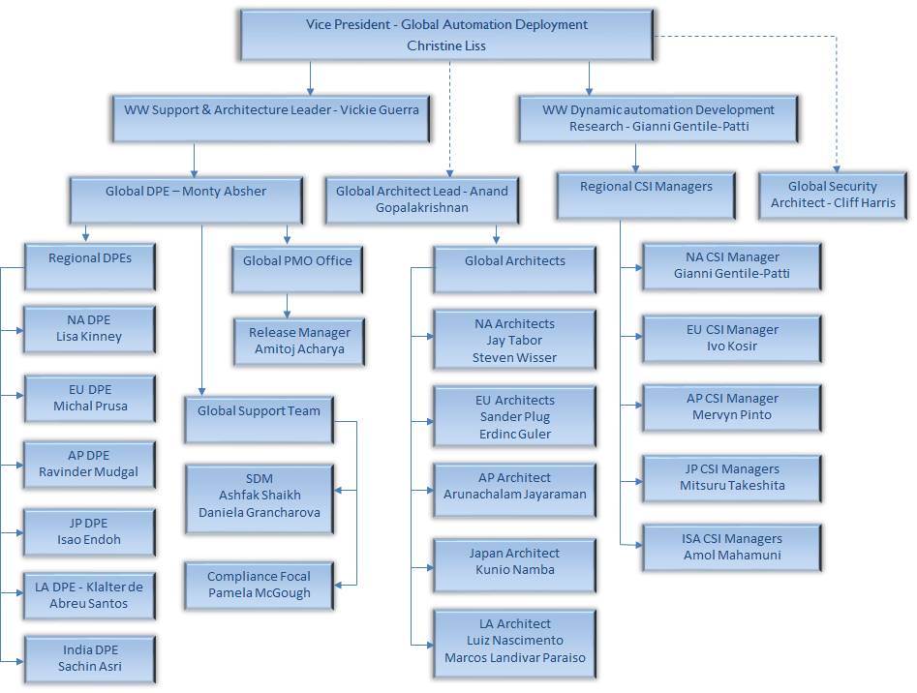
Dynamic Automation – Support Organization (As of 15 January 2018)

Slide 25
Dynamic Automation expansion roadmap
Increased automation opportunity via increased activities
Activity types
Different input / triggers
Health checking *
RFS
Problems/incidents *
Change Requests
Service requests *
Scheduled events *
Learn automation opportunities across multiple platforms
Greater variety
Automation opportunity decreases with increasing complexity
Distributed Server Management *
Application Hosting
DB *
Operations
Storage *
Network *
ID and Access Management *
Middleware Management
Application Management
* Dynamic Automation Expansion Projects Underway
Different disciplines (towers)
Notes:
We use an analytics-driven Continual Service Improvement approach to grow the Dynamic Automation capability for our clients. We start by analyzing the client’s incidents history for pattern identification (lowest hanging fruit). From there the impact of this capability is furthered by evaluating additional: 1) Volumes: use cases and end-nodes, 2) Disciplines: functional areas above and beyond server support, and 3) Triggers: input to automation other than incident reaction.

Slide 26

Thank you!
For more information, please visit:
http://www.ibm.com

